Slide 1
Chapter 8
Taking Tests Successfully

Slide 2

Assess Your Strengths and Set Goals
Tests and exams are an unavoidable component of college life. They are the ways that instructors will evaluate your learning.
How would you rate your abilities as a test taker? Do you experience test anxiety? Consider how you might improve in these areas.

Slide 3

Getting Ready…
There are several ways to prepare for taking a test. Here are some examples:
Ask you instructor about the test format.
Join a study group.
Talk to students who have previously taken the course.
Notes:
Instructors: Ask students what other methods they might use to prepare for a test.
Other methods discussed in the text include:
Design an exam plan
Use online quizzing
Get a tutor

Slide 4

http://drive.google.com/file/d/1JuIoSZVKT6EUqHqD-h9lO34-oSwtrgoW/view
Notes:
Instructors: Ask your students the following questions from the Preparing for Tests video activity from LaunchPad.
How does time help you prepare for tests? For you, how much time and how frequently before a test do you need to study to feel prepared?
While studying, what is the value of making connections between the materials the test will cover? How does this help you better understand the material the test will cover?
Why would you not want to spend a lot of time studying the day before or day of the test? Is that counterintuitive?

Slide 5
Math and Science Exams
Math and science exams often require additional—and sometimes different—preparation techniques:
Do your homework regularly.
Attend each class, always be on time, and stay for the entire class.
Keep a list of definitions or important formulas and put them on flash cards.

Slide 6
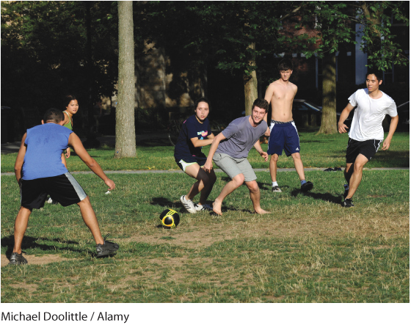
Prepare Physically
Keeping your body healthy is a key part of preparing for tests. To do this:
Maintain your regular sleep routine.
Follow your regular exercise program.
Eat right.

Slide 7

Prepare Emotionally
Your attitude and emotions are also important to test preparation. To prepare emotionally:
Know the material.
Practice relaxing.
Use positive self-talk.
How often have you crammed in a last-minute review of notes before a test?
Notes:
Instructors: Use the question on the slide as a discussion starter. Tell the class that last-minute cramming usually will not improve a test score. It is better to prepare early and try to relax before the test starts.

Slide 8
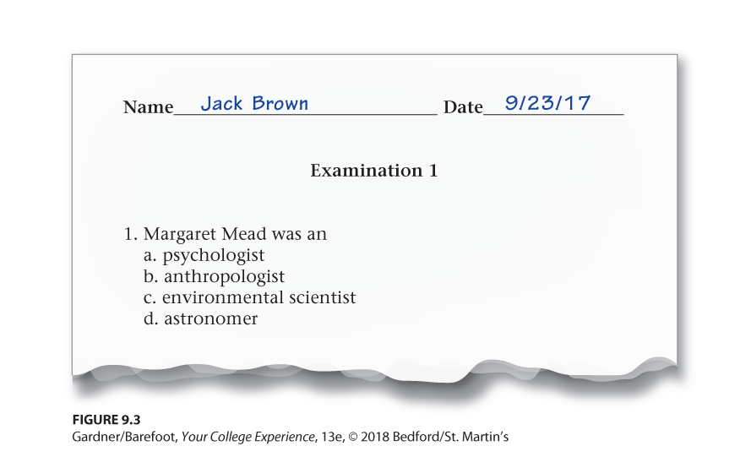
Tips for Test Taking
Answer the easy questions first.
Try to answer each question, even if its a partial answer.
If you finish early, don’t leave immediately. Check your work for errors.
Can you think of any other test-taking tips?
Notes:
Instructors: Inform students that throughout their college career, they will take tests in many different formats, in different subjects, with different question types. These test-taking tips apply to any test situation.
As a discussion starter, ask the class what other tips they might use for taking a test. Other tips from the chapter include:
Write your name on the test
Look over the whole test and stay calm
Make the best use of your time
Jot down idea starters before the test
If you feel panic or go blank, stop whatever you are doing and take a deep breath to calm yourself, then try going to another section of the test if possible.

Slide 9

http://drive.google.com/file/d/128KSDerc5I0_VaWLjittcXpbrR2NRD7N/view
Notes:
Instructors: Ask the class the following questions from the Test Taking Advice video activity in LaunchPad.
Why do you think you should not change your original answer when you go back and review your test before turning it in?
How true is this statement: “Preparation for a test can limit the anxiety you feel when taking the test?” What are some ways you might combat test anxiety?
What does your ideal study group look like? Who is in this group? How is it formed? How do you work together?

Slide 10
Types of Tests
You will encounter many different types of tests in college, including:
Machine-scored
Problem-solving
Computerized
Notes:
Instructors: Ask students what other types of tests they have encountered or think they will encounter in college? Other examples include:
Laboratory tests
Open-book/open-note tests
Take-home tests

Slide 11
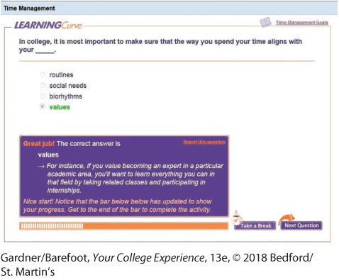
Tech Tip: Conquer Online Tests
In college you may encounter tests that are administered online. Here are some effective online test-taking techniques:
Resist the temptation to surf the Web for answers.
Stay focused and don’t fall prey to online diversions.
Plan for an intermittent connection.
Notes:
Instructors: Discuss with students some other tips for taking online tests. Examples from the chapter are:
Study with other people
Get organized
Work together if the instructor allows collaboration
Budget your time
Practice using the test interface
Ask about special rules, such as if you can retake the test or go back and change an answer
Use all of the time alloted

Slide 12
Types of Questions
In addition to a variety of tests and exams, you will be exposed to a variety of questions.
Question types frequently found in school are essay, multiple choice, fill-in-the-blank, true/false, and matching.
Is one type of exam better than another? Which type do you prefer?
Notes:
Instructors: Use the question at the end of the slide as a discussion starter. This will help students reflect on the types of exams they might take during their first term of college.

Slide 13
Essay Questions
Essay questions require students to write a few paragraphs in response to each question. Here are some guidelines for answering essay questions:
Budget your exam time.
Actively read the whole question.
Develop a brief outline before you write.
Notes:
Instructors: Other guidelines to share with students include writing concise, organized answers and knowing the key task words in essay questions.

Slide 14

Multiple-Choice Questions
Multiple-choice questions provide a number of possible answers. Some tips for multiple-choice questions are:
Be careful of questions using not, except, all, but.
Be suspicious of choices using always, never, only.
Disregard choices that are grammatically incorrect.
Notes:
Instructors: Tell students that when answering multiple-choice questions, the first answer that comes to mind is usually the correct one.

Slide 15
Fill-in-the-Blank Questions
Fill-in-the-blank questions consist of a sentence with a blank line for a missing word. Tips for answering these questions are:
Answers may be a single word or a phrase.
A series of blanks is a clue about the number of words, but there may be just one long blank.
If you are unsure, ask the instructor whether the answer should be one word or more.

Slide 16
True/False Questions
True/False questions ask you to determine whether a statement is correct or not. Some tips to remember about True/False questions are:
To be true, every detail of the sentence must be correct.
Questions using always, never, and only tend to be false.
Questions using often and frequently may be true.
Notes:
Instructors: Tell students that another tip for True/False questions is to read through the entire exam to see whether the information in one question will help them answer another.

Slide 17
Matching Questions
Matching questions ask you to match the proper term with its definition. Some tips to remember:
Before matching any items, review all terms and descriptions.
Match terms you are sure of first.
Use process of elimination to help answer remaining items.
Notes:
Instructors: Tell students that some other tips for answering matching questions include crossing out terms and definitions/descriptions as they answer. Students can prepare for matching questions with flash cards and lists.

Slide 18

Test Anxiety
Test anxiety is common among college students and has many causes:
Excessive pressure from yourself or others
Lack of preparation
Procrastination
Notes:
Instructors: As a discussion starter, ask students to share their experiences with test anxiety and have them identify what the causes behind their experiences were.

Slide 19
Where to go for help…
A little anxiety is OK
If you find that your anxiety is getting in the way of your performance on tests and exams, you can consult your college counseling center.

Slide 20
Symptoms of Test Anxiety
Test anxiety can manifest itself in many ways, including physical symptoms:
Butterflies in the stomach
Headaches
“Going blank” during the exam
What are some other physical symptoms of test anxiety?
Notes:
Instructors: Use the question in the slide as a discussion starter and have students name some other symptoms of test anxiety. Other symptoms found in this chapter are:
Queasiness
Nausea
An increased heart rate
Hyperventilation
Shaking, sweating, or muscle cramps

Slide 21
Types of Test Anxiety
Some students experience anxiety during standardized tests
Ex: SAT, ACT, college placement tests
Some students anxiety on tests in specific subjects
Identify some subjects or tests that might give you test anxiety.
Notes:
Instructors: As a discussion starter, have students identify some subjects or tests that give them test anxiety.

Slide 22
Strategies for Dealing with Test Anxiety
In addition to studying, eating right, and getting enough sleep, there are several simple strategies to help manage test anxiety:
Breathe
Stretch
Create positive mental messages.
Notes:
Instructors: You can ask students how breathing, meditation, and exercise can reduce test anxiety. Other strategies for dealing with test anxiety include:
Sit in a relaxed position
Keep your confidence high

Slide 23
Getting the Test Back
Reviewing your graded tests allows you to:
Evaluate your own knowledge
See if the instructor made a grading error
Figure out why you made mistakes to avoid making similar mistakes again
Notes:
Instructors: Remind students that they should not let a bad grade get them down! The characteristic that differentiates successful students from unsuccessful students is resilience.

Slide 24
Cheating
There are many ways colleges define cheating. Some are:
Looking over a classmate’s shoulder for an answer.
Obtaining or discussing an exam or individual exam questions without permission.
Purchasing term papers over the Internet.
What actions do you consider cheating?
Notes:
Instructors: Use the question on this slide as a discussion starter, and have students provide examples of behaviors they would consider cheating. Other definitions from the text include:
using a calculator when it is not permitted
copying someone else’s lab notes
watching the video instead of reading the book
copying computer files

Slide 25
Prohibited Activities
In addition to cheating, many schools prohibit other activities, including:
Intentionally inventing information or results.
Giving answers to another student to copy during or before an exam.
Bribing anyone in exchange for an academic advantage.
Notes:
Instructors: Discuss with students some of the other prohibited activities discussed in the text.
submitting the same piece of academic work for credit in more than one course
helping or trying to help another student commit a dishonest act
Ask students to collect information about their college’s definition of cheating and policies for addressing infractions of its rules.

Slide 26

Why Students Cheat
There are many reasons why students cheat:
Believe they cannot do well on their own.
Do not know the rules.
Lack of preparation.
Can you think of any other reasons that students might cheat?
Notes:
Instructors: Use the question on this slide as a discussion starter. Have students provide reasons for why they think others cheat. Other possible reasons from the chapter include:
cultural and college differences
pressure from others

Slide 27
The Consequences of Cheating
Cheating can lead to suspension, expulsion, or even revocation of your college degree.
Steps to reduce problems with academic honesty:
Know the rules.
Seek help.
Reexamine goals.
Notes:
Instructors: Ask students what other steps they might take to reduce problems with academic honesty and how these steps are helpful. Other options from the chapter include:
Set clear boundaries
Improve time management
Withdraw from the course

Slide 28
Make Good Choices
An important part of being a student is understanding academic integrity.
There are some actions on the line between cheating and being honest.
Imagine that you get answers from another student who took an exam you’re about to take in a prior term. Would you consider this cheating?
Notes:
Instructors: The question above is taken from the Your Turn activity at the end of the chapter. Use it as a discussion starter and share your own opinions about the difference between cheating and being honest.

Slide 29
Reflection
Test taking is an inevitable part of college life. But you can choose how you are going to prepare, deal with anxiety, and pay attention to your grades.
Identify your next upcoming test or exam? What strategies will you use to prepare?

